Slide 1
DATA STRUCTURES & ALGORITHMS

Slide 2
CONTENTS
Why is Linked List ?
Types of Linked Lists.
Linked List Operations.

Slide 3
01
What is Linked List ?

Slide 4
What is LinkedList ?
a dynamic data structure whose size increases as you add the elements and decreases as you remove the elements from the list.
LinkedList is a linear data structure used to store the elements in contiguous locations.
Each LinkedList has head (first node) and tail (last node).
The LinkedList stores its items in "containers." The list has a link to the first container and each container has a link to the next container in the list.
A container is also known as a node.
Each node consists of two parts , the first is data and the second is a pointer (link) to the next node.

Slide 5
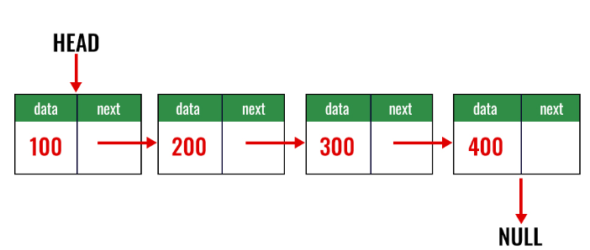
What is Linked List ?
TAIL

Slide 6
02
Types of Linked Lists.

Slide 7
Types of Linked Lists.
There Are Various Types of Linked List. They Are:
  Singular Linked List.
  Doubly Linked List.
  Circular Linked List.

Slide 8
03
Operations of Linked Lists.

Slide 9
Operations of Linked Lists.
Traversal: accessing all the elements of the list starting from the head node to the last node.
Insertion: To add/insert a new node to the list.
Deletion: To remove any existing node from the list.
Searching: To find a node in the list.

Slide 10
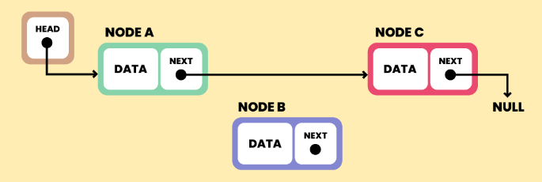
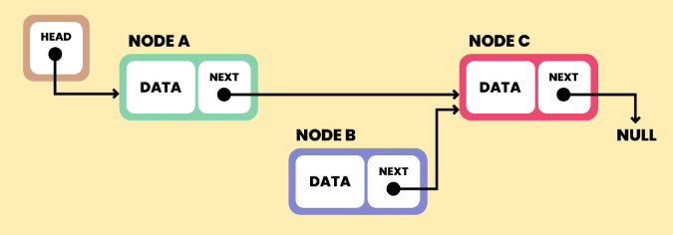
Operations of Linked Lists.
Insert :
(1)
(2)

Slide 11
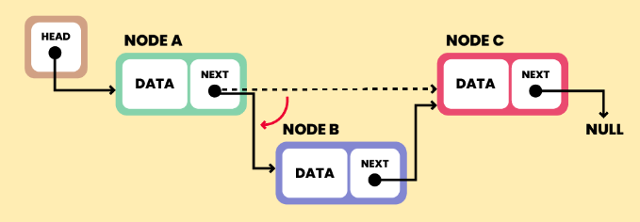
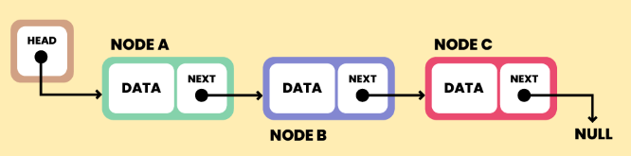
Operations of Linked Lists.
Insert :
(3)
(4)

Slide 12
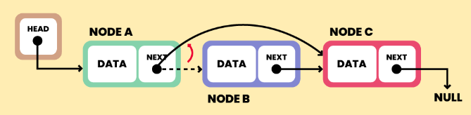
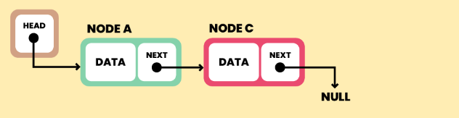
Operations of Linked Lists.
Deletion :
(1)
(2)

Slide 13
THANKS

